Slide 1
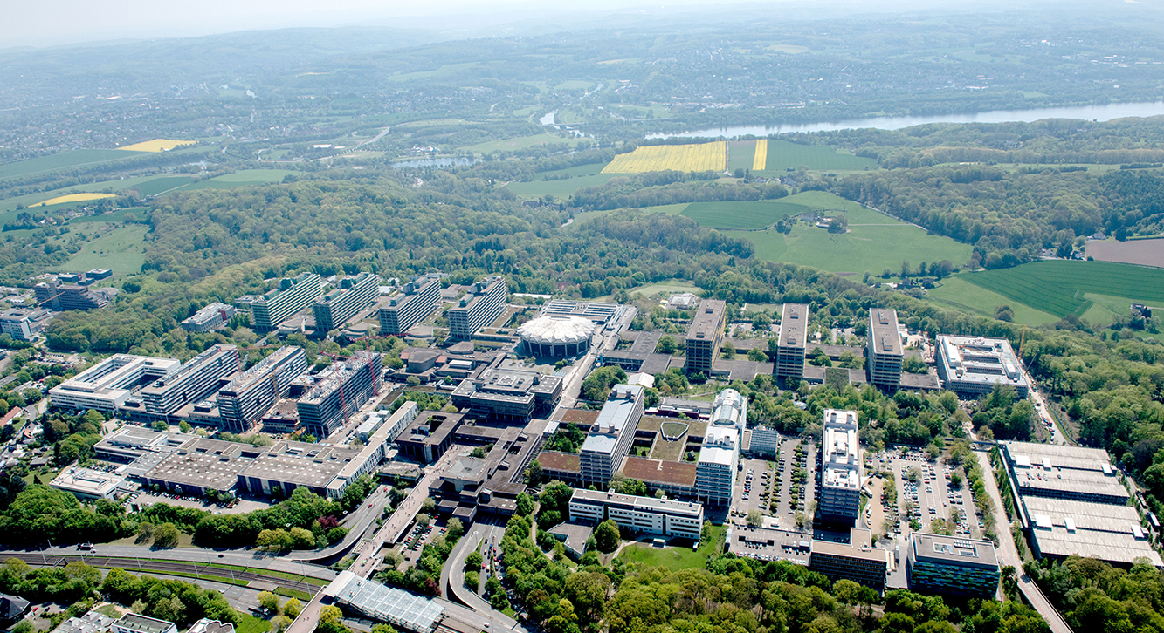

Hier Bild von Ausgabe einfügen
Perceptron Algorithm
Parallel Computing SS18
Lennard Flegel, Alexander Mardorf, Bajram Ibishi, Franziska Thiemann

Slide 2
Outline
The Perceptron learning Algorithm
What it does
How it does that
Why it works
Software architecture
Going Parallel
Our implementation
Benchmarking etc
In a perfect world
In a world without race conditions
In our world
Conclusion
OPM JAVA
Sources

Slide 3
The Perceptron Learning Algorithm (PLA)

Slide 4


Supervised Learning
Learning Algorithm
Model
Dog
Size: ***
Weight: ****
Cat
Size: **
Weight: ****
Cat
Size: **
Weight: **
Cat
Size: **
Weight: *
Extracting a rule from a set of correct data
Dog
Size: *****
Weight: ****

Slide 5


Supervised Learning
Model
Garfield = Cat
Odie = Dog

Slide 6
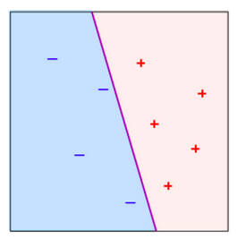
Visualizing the separator
weight
Purple line:
the separator or previously „model“
size

Slide 7
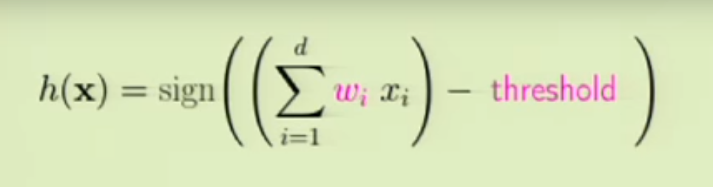
Supervised Learning

Slide 8
Supervised Learning
Weighted sum of attributes:
Like weight, size …

Slide 9
Supervised Learning
Weighted sum of attributes
Substract threshold

Slide 10
Supervised Learning
Weighted sum of attributes
Substract threshold
Check sign: + or -

Slide 11
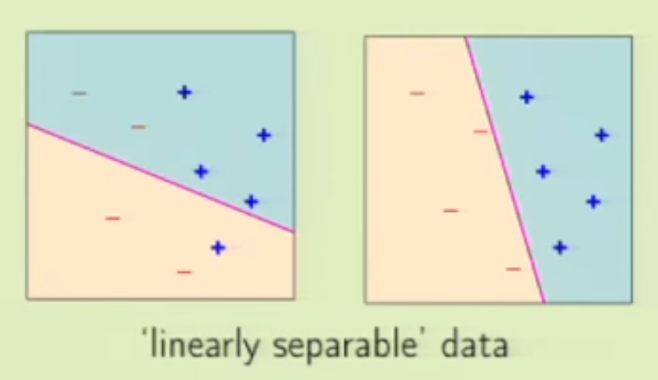


Supervised Learning
Weights and threshold together form a separator

Slide 12
Supervised Learning
But wait… That doesn‘t seem right?

Slide 13
Supervised Learning
Finding the proper separator is the „learning“ part

Slide 14
WARNING
No more cats and dogs from here on

Slide 15
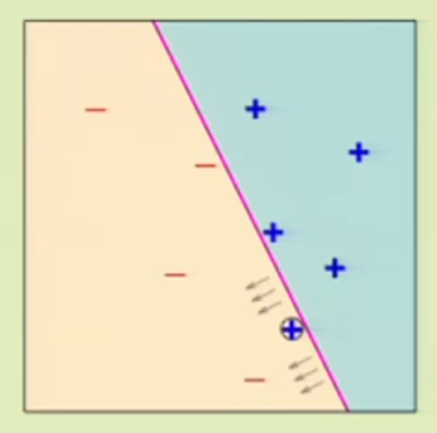
Supervised Learning
i = 0;
w(i) chosen randomly;
WHILE w(i) is not the solution AND i < MAXIMUM_ITERATIONS DO
choose any misclassified point p
change w(i+1) and threshold based on p
i++;
END

Slide 16
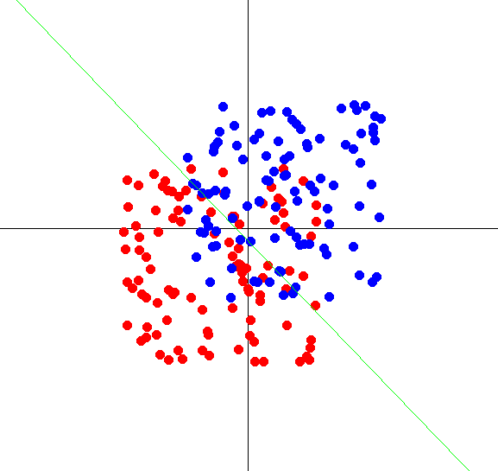
Pocket-PLA

Slide 17
Pocket-PLA
i = 0;
bestWeightset = null; //the pocket where we keep the best result
w(i) chosen randomly;
WHILE w(i) is not the solution AND i < MAXIMUM_ITERATIONS DO
if (w(i) better than bestWeightset)
bestWeightset = w(i);
choose any misclassified point p
change w(i+1) and threshold based on p
i++;
END

Slide 18
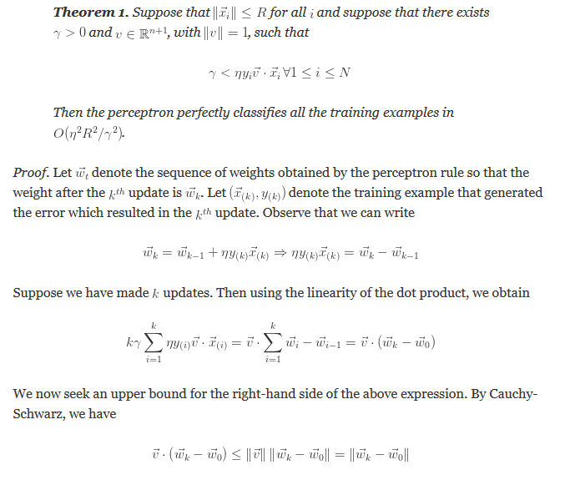
Proof
Notes:
Hier Idee zur Parallelisieren oder weiter unter ?

Slide 19

Proof
Notes:
Hier Idee zur Parallelisieren oder weiter unter ?

Slide 20
Proof
TL;DR:
It works
Notes:
Hier Idee zur Parallelisieren oder weiter unter ?

Slide 21
Class diagram
Notes:
Einzelne Klassen kurz vorstellen, Logik explizit vorstellen

Slide 22
Perceptron Algorithm
Unserer Anpassung des Algorithmus
Notes:
Hier Idee zur Parallelisieren oder weiter unter ?

Slide 23
Going Parallel
dsdsdsdsd
Notes:
Idee der Parallelisierung vorstellen

Slide 24
Parallele Teil des Programms
dsdsdsdsd
Notes:
Idee der Parallelisierung vorstellen

Slide 25
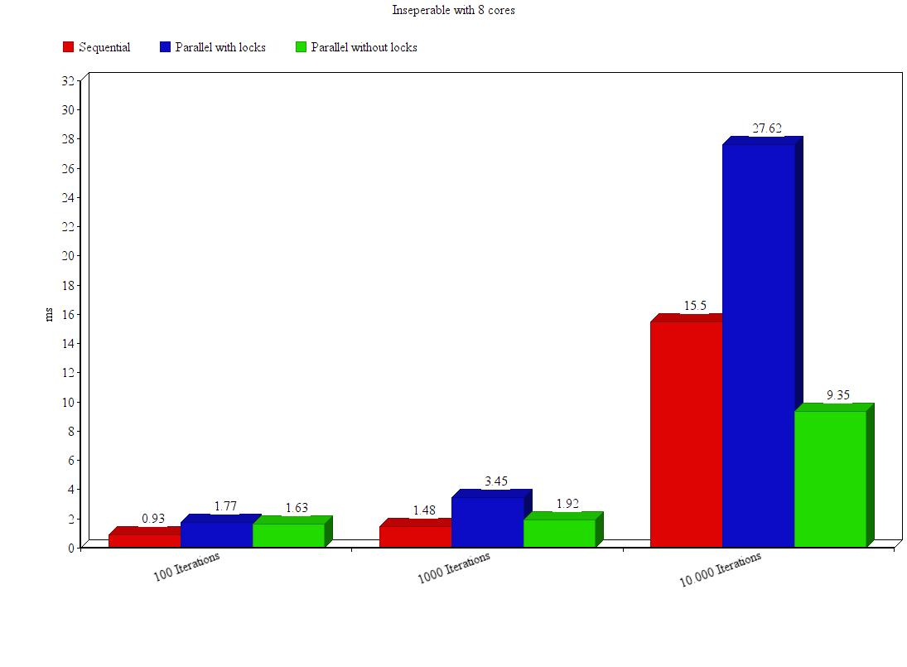
Benchmarks
Notes:
Idee der Parallelisierung vorstellen

Slide 26
Benchmarks
Overhead caused by Java Threads
Notes:
Idee der Parallelisierung vorstellen

Slide 27
Parallel Problems
Algorithm is by ist nature not efficiently parralellizable:
All threads share „weights“ variable causing race conditions
Synchronized blocks + thread overherad hinder better performance
Notes:
Idee der Parallelisierung vorstellen

Slide 28
Parallel Problems
dsdsdsdsd
Notes:
Idee der Parallelisierung vorstellen

Slide 29
Conclusion
Reflection on what this research aimed for:
Efficient parallel implementation of the perceptron learning algorithm
Reflection on research and methods:
We had troble with the software that was to be used (OMP4J)
So we could not work the way we planned to
Result is not satisfactory as a consequence
Reflection on the final result:
goal was not achieved, algorithm with JAVA threads caused race conditions
Synchronization required
no speedup can be achieved
Whats to be discussed :
Better with C-style preprocessor OpenMP?
Notes:
Idee der Parallelisierung vorstellen

Slide 30
Sources
Dsdsdsdsd
Notes:
Idee der Parallelisierung vorstellen

